Slide 1

FLOOD MONITORINGAND EARLY WARNING

Slide 2
Introduction
Welcome to this presentation on Flood Monitoring and Early Warning.
1
Flooding is a widespread and destructive natural disaster, impacting communities worldwide.
2
This presentation will highlight the importance of flood monitoring and early warning systems.
3

Slide 3
Understanding Floods
Definition: A flood is an overflow of water onto normally dry land.
Causes: Rainfall, snowmelt, dam failure, storm surge, and rapid urbanization.
Impact: Loss of life, property damage, disruption of communities, and economic losses.

Slide 4
The Need for Early Warning
Rapid onset of floods leaves little time for response.
Early warning systems save lives and reduce economic damage.
Effective early warning requires reliable monitoring and communication.

Slide 5
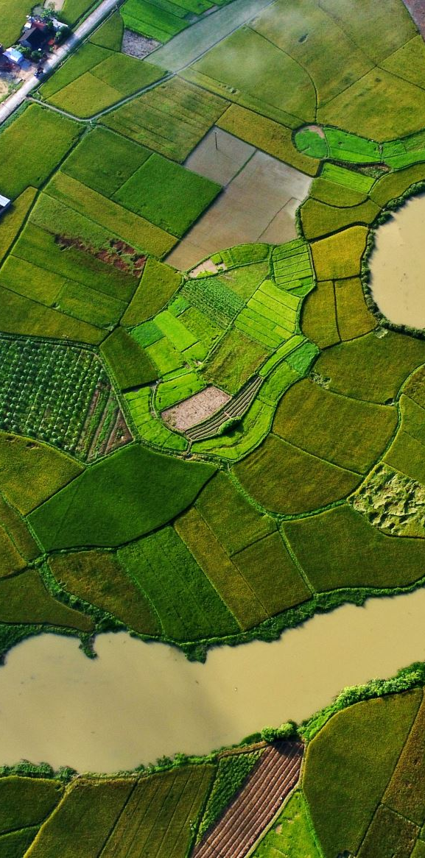
Components of Flood Monitoring and Early Warning
4.1 Flood Monitoring
Weather Forecasting: Monitor rainfall, snowmelt, and weather patterns.
River Gauges: Measure water levels in rivers and streams.
Radar and Satellites: Track storm systems and rainfall.
Soil Moisture Sensors: Assess soil saturation levels.
Remote Sensing: Use technology to gather data from hard-to-reach areas.
4.2 Data Collection and Analysis
Data from various sources is collected and analyzed in real-time.
Advanced modeling and algorithms help predict potential flood events.

Slide 6
Early Warning Systems
When monitoring detects potential flooding, early warning systems come into play.
5.1 Alerting Authorities
Automatic alerts are sent to government agencies responsible for disaster response.
5.2 Community Alerts
Public alerts are issued through various channels (TV, radio, mobile apps).
Evacuation orders and safety instructions are communicated to residents.

Slide 7
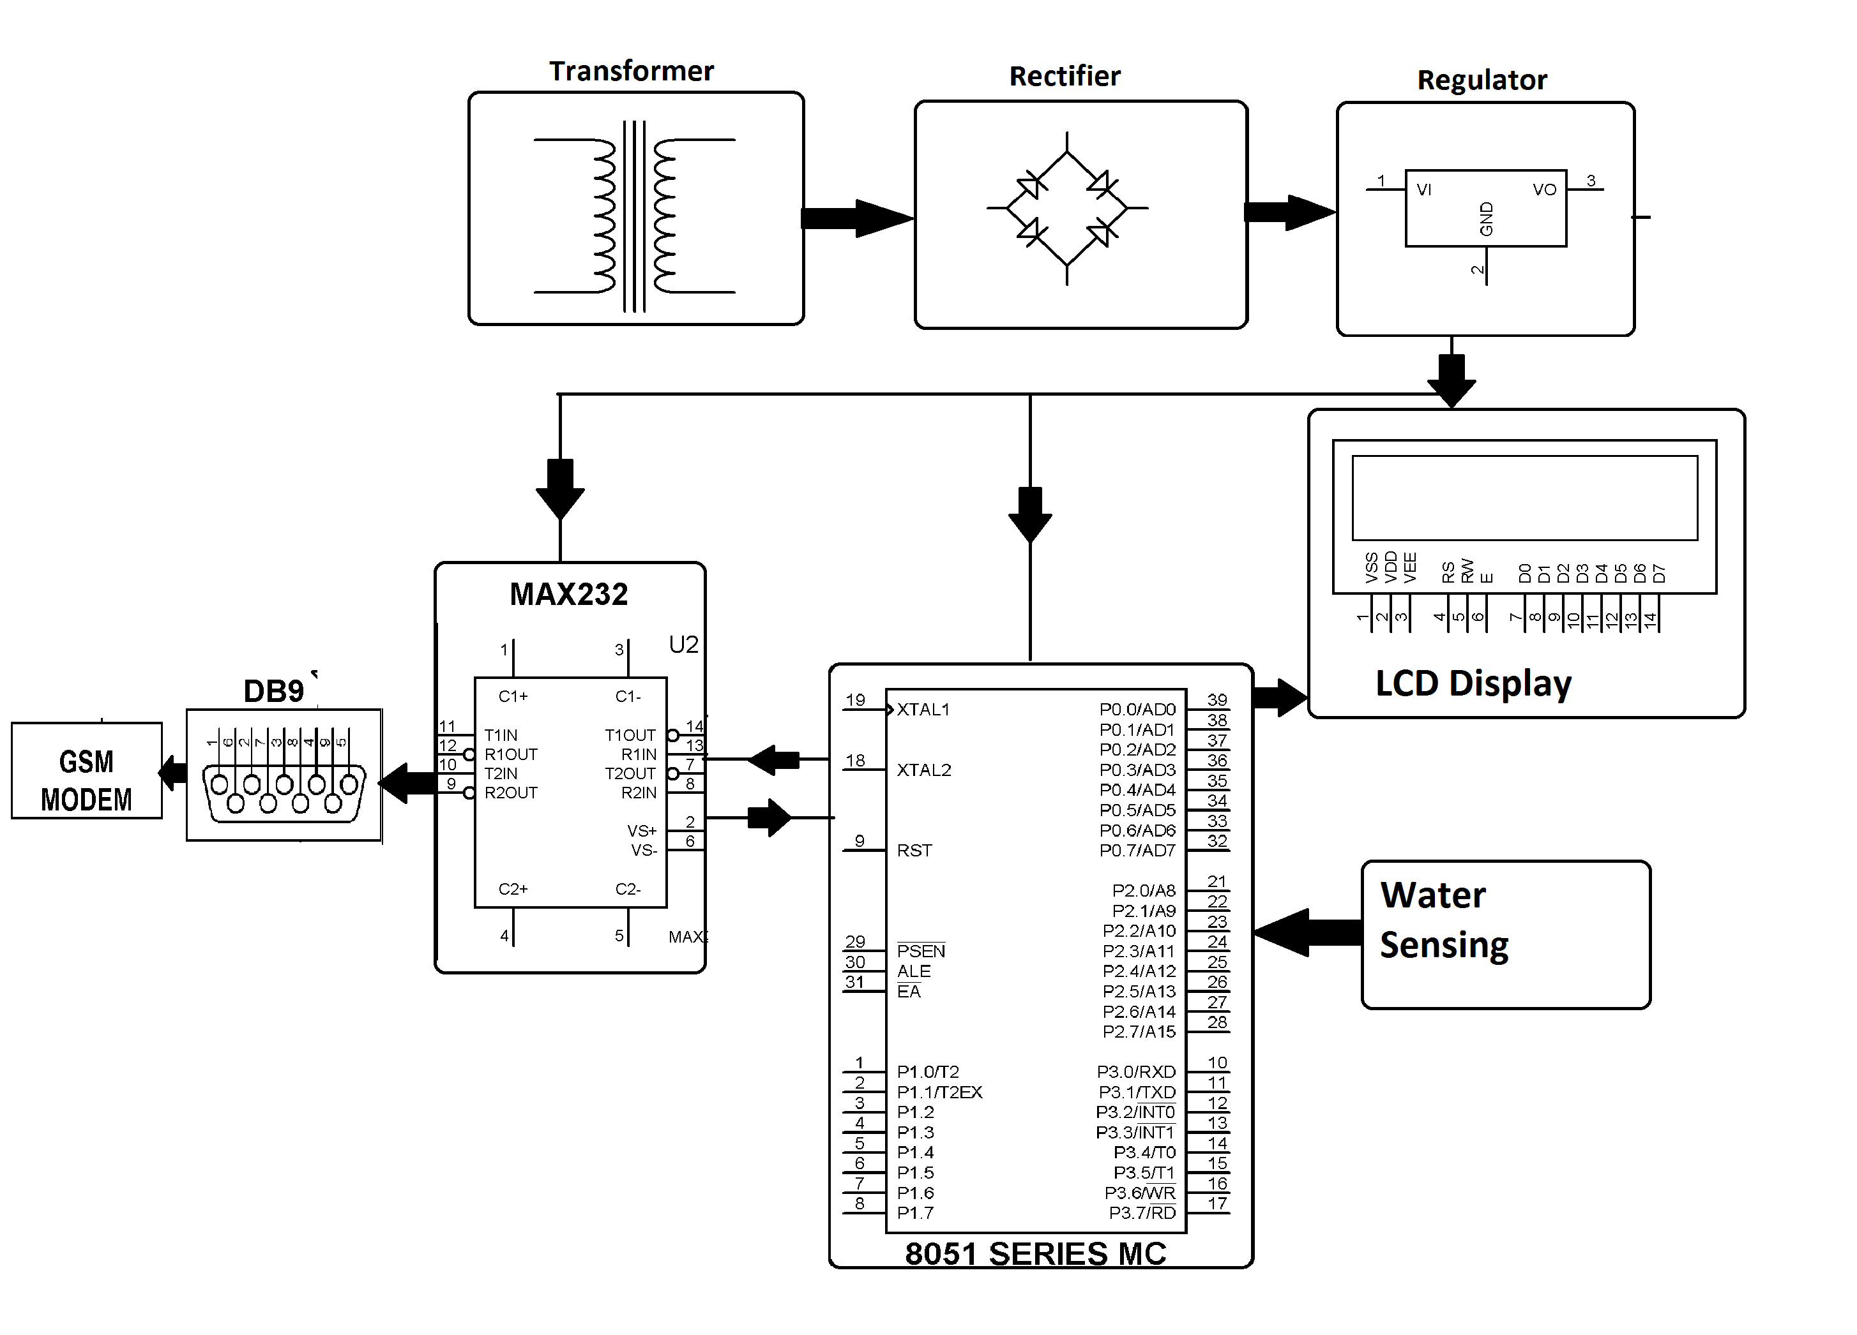
Circuit diagram

Slide 8

Technological Advancements
Advances in technology have greatly improved flood monitoring and early warning systems.
6.1 Artificial Intelligence (AI)
AI algorithms can analyze data faster and more accurately.
Predictive models become more reliable.
6.2 Internet of Things (IoT)
IoT devices can provide real-time data from remote locations.
Smart sensors in flood-prone areas enhance monitoring.

Slide 9
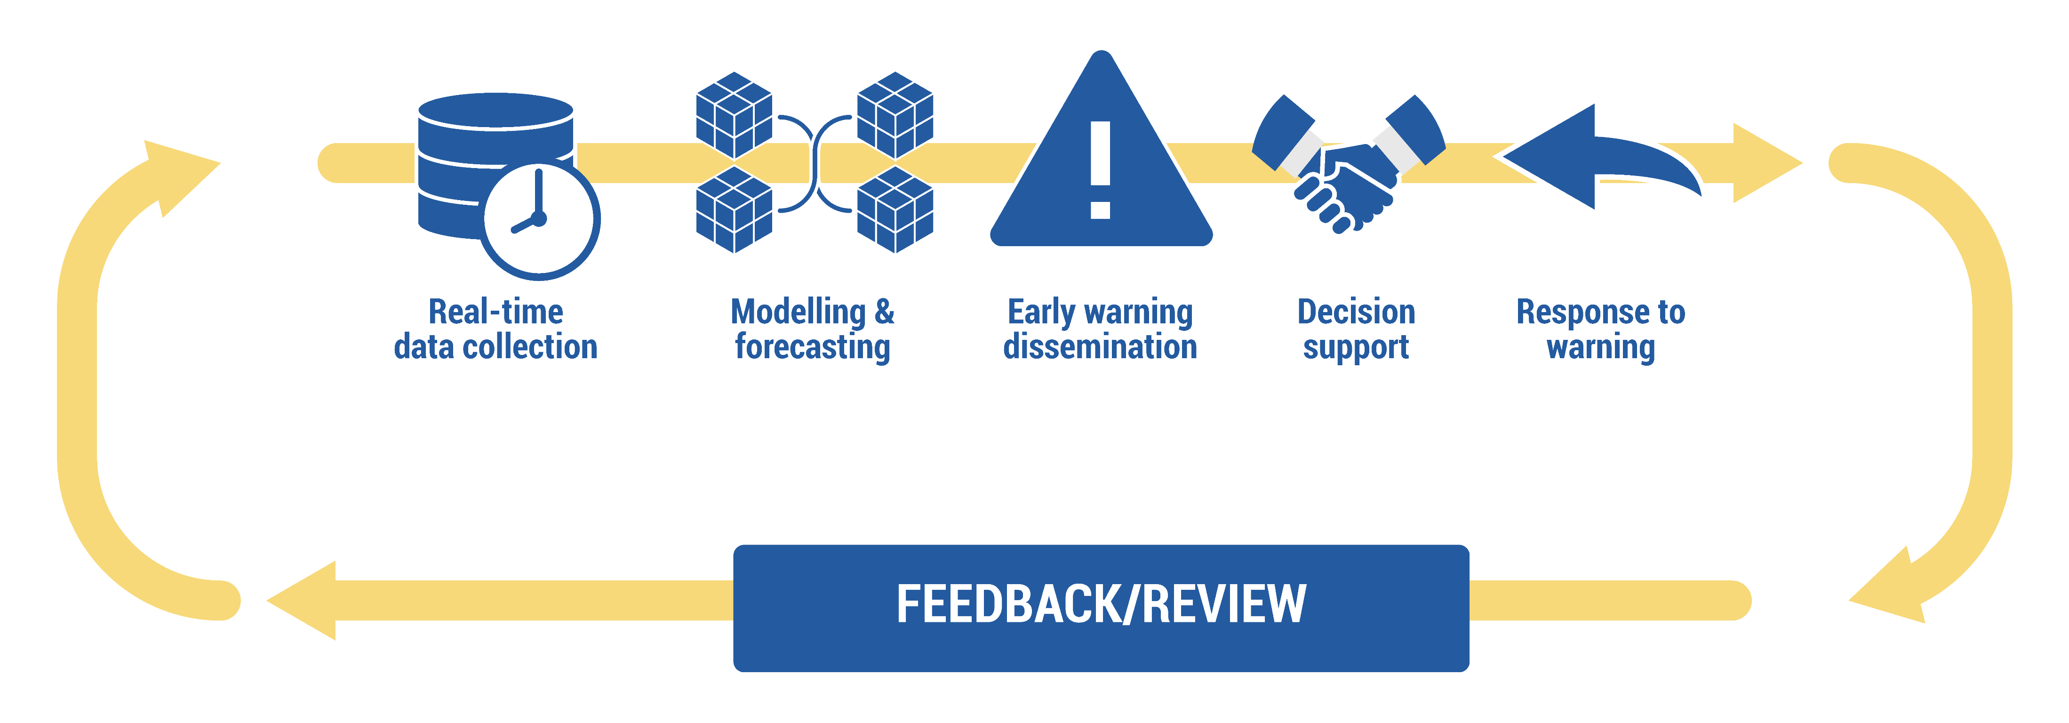
Model diagram of FLOOD MONITORING AND EARLY WARNING

Slide 10
Success Stories
Highlight successful early warning systems:
Japan's J-Alert System
The Netherlands' Delta Works
India's Flood Early Warning System (FEWS)

Slide 11
Challenges and Benefits
Funding and infrastructure limitations.
Data accuracy and reliability.
Public awareness and community preparedness.
Benifits
Lives saved and reduced human suffering.
Minimized property damage and economic losses.
Enhanced disaster resilience in communities.

Slide 12

Conclusion
Flood monitoring and early warning systems are crucial for disaster preparedness.
Continued investment in technology and infrastructure is necessary.
Together, we can mitigate the impact of floods and protect communities.

